Slide 1
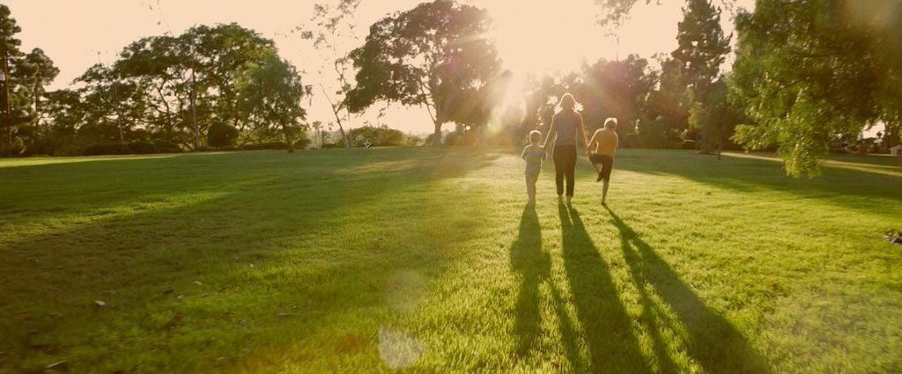
Cooperation
Consequences,
and Keeping Your Sanity
Dr. Scott Turansky and Joanne Miller, RN, BSN

Slide 2
What is
the Heart?

Slide 3
Cooperation,
Consequences,
and Keeping Your Sanity
Dr. Scott Turansky and Joanne Miller, RN, BSN

Slide 4
Session 1
Teaching Children to Listen
and Follow Instructions

Slide 5
Tendencies
Reflect
the Heart

Slide 6
Focus on
Relational
Routines

Slide 7
Step 1 for the Parent:
Get Close to Your Child

Slide 8
Step 1 for the Parent:
Get Close to Your Child
Step 1 for the Child:
Learn to Come When Called

Slide 9
Step 2 for the Parent:
Consider the Timing

Slide 10
Step 2 for the Parent:
Consider the Timing
Step 2 for the Child:
Always Be Ready
to Receive an Instruction

Slide 11
Step 3 for the Parent:
Give the Instruction

Slide 12
Step 3 for the Parent:
Give the Instruction
Step 3 for the Child:
The Child Answers

Slide 13
Step 4 for the Parent:
Wait Expectantly

Slide 14
Step 4 for the Parent:
Wait Expectantly
Step 4 for the Child:
Do the Job as if on a Mission

Slide 15
Step 5 for the Child:
Report Back

Slide 16
Step 5 for the Child:
Report Back
Step 5 for the Parent:
Inspect and Release

Slide 17
Session 1
Teaching Children to Listen
and Follow Instructions

Slide 18
Hide God’s Word
In Your Child’s
Heart

Slide 21
15 Minute Break
Then
Session 2
Correction Ideas
That Touch the Heart

Slide 22
Session 2
Correction Ideas
That Touch the Heart

Slide 23
Proverbs 6:23 says:
“the corrections of discipline
are the way to life”

Slide 24
Step 1
Use Words
“All Scripture is God-breathed and
is useful for teaching, rebuking, correcting and training in righteousness” —2 Timothy 3:16

Slide 25
Step 2
A Break

Slide 26
REPENTANCE—
A Change of Heart
Stop fighting, calm down, and
be willing to talk about the problem
Acknowledge wrong-doing
Recognize that there’s a better way
Commit to doing right
Feel sorrow for wrong-doing
Have a desire to do what’s right

Slide 27
Transfer
Responsibility
to the Child

Slide 28
3
Three Distinctives
Make the Break Work:

Slide 29
3
Three Distinctives
Make the Break Work:
The child is sent on a
mission to change the heart

Slide 30
3
Three Distinctives
Make the Break Work:
The child is sent on a
mission to change the heart
The child helps determine the
length of time spent in the Break

Slide 31
3
Three Distinctives
Make the Break Work:
The child is sent on a
mission to change the heart
The child helps determine the
length of time spent in the Break
The motivation to come out of the
Break is that the child is missing
out on the benefits of family life

Slide 32
PRACTICAL QUESTIONS
But You Don’t Know
My Kids
My child who goes to a Break but has
a tantrum while there.
My child follows me around the house
and refuses to go to the Break.

Slide 33
Step 2
A Break

Slide 34
What About
Consequences?

Slide 35
Use a Map Mentality as Your
Strategy

Slide 36
1 • Natural
Consequences

Slide 37
2 • Logical
Consequences

Slide 38
3 • Restricting
Freedom

Slide 39
4 • More Parental
Control

Slide 40
5 • Spanking

Slide 41
6 • Other Leaders
and Authorities

Slide 42
7 • Positive Side
of the Toolbox—
Training

Slide 43
Conference Special

Slide 44
4 Book Special

Slide 45
I Want it All Special

Slide 46
Don’t Miss Session 3
Ending Discipline Times
with Impact
1:10 pm starting with Q&A

Slide 47
Session 3
Ending Discipline Times
with Impact

Slide 48
Discipline Is
More Valuable
Than Punishment

Slide 49
A Positive Conclusion
is a discussion you have with
your child after the consequence
to clarify the offense, make a
plan for next time, and offer
encouragement to do the
right thing.

Slide 50
Question 1:
“What did you do wrong?”

Slide 51
Confession
is a spiritual issue, and it’s
learned in the Positive
Conclusion.

Slide 52
Question 2:
“Why was that wrong?”

Slide 53
Question 3:
“What are you going to do
differently next time?”

Slide 54
A Statement:
“OK, go ahead and try again.”

Slide 55
The
Positive Conclusion
is an Adult Skill

Slide 56
There’s
Always
Hope!

Slide 57
Most Importantly
Invite Jesus
Into Your
Life

Slide 58
Cooperation,
Consequences,
and Keeping Your Sanity
Dr. Scott Turansky and Joanne Miller, RN, BSN

